Slide 1
Machine Learning
SPC FINDINGS
Dean Foulds

Slide 2
Introduction
Dean Foulds holds a Bsc(Hons) in mathematics physics from the Open University and a qualified pilot and engineer.
10 years' experience machine learning
College lecturer in Aeronautical Engineering and T-Level Engineering
Currently employed as a quality engineer

Slide 3
Overview
This study focused on whether machine learning can accurately predict failures from SPC analysis.
Causes of amp failures
Effects of failures
Predicting latent errors

Slide 4
Causes of amp failures
Tight Fibre
Pulled fibre
Poor routing
Pressure from foam
Too many fibres
Poor routing
Issues during manufacture

Slide 5
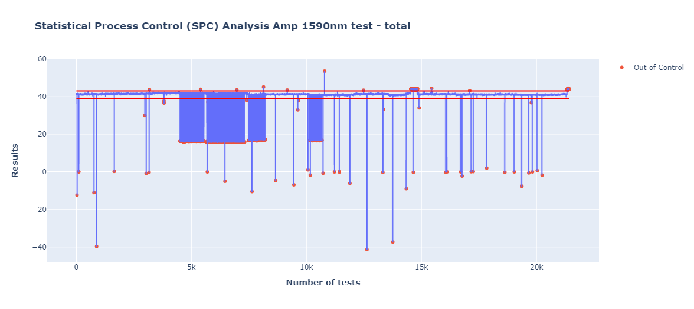
SPC results – all amp tests

Slide 6
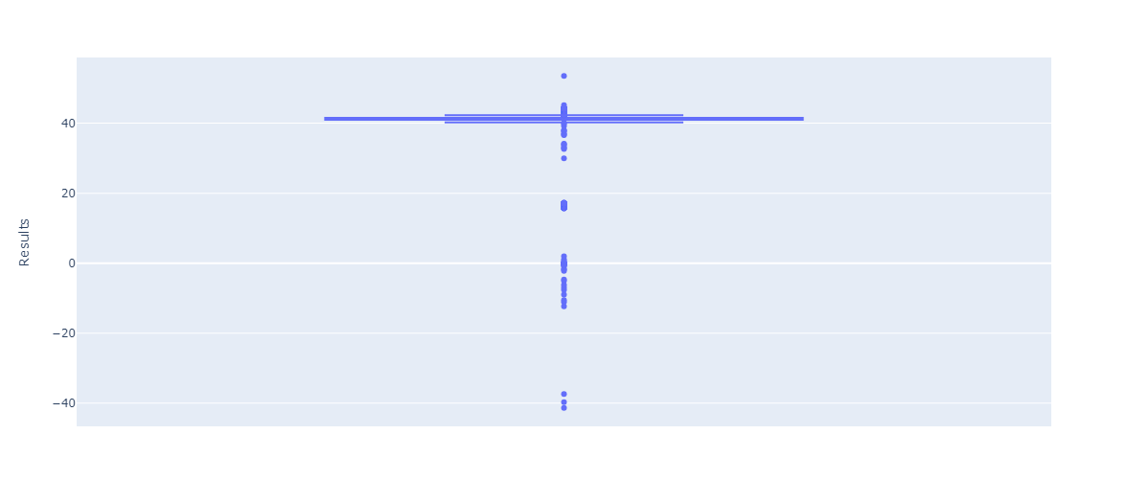
Visualising the outliers

Slide 7
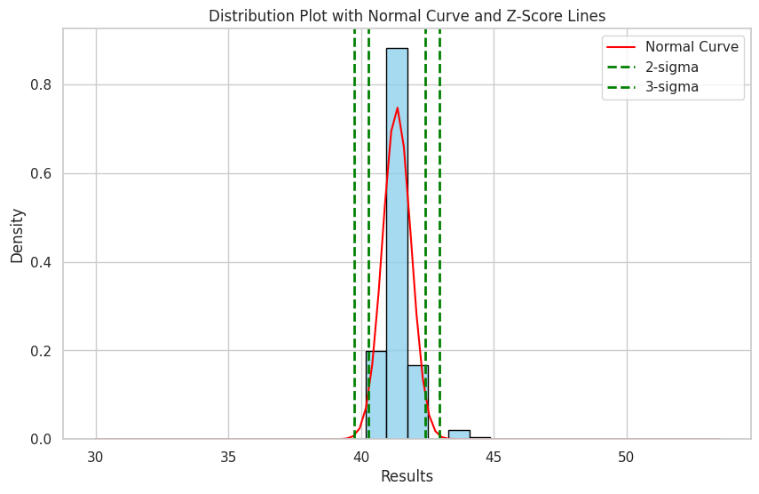
Distribution analysis

Slide 8
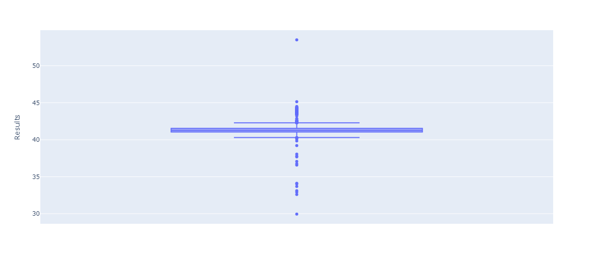
Outliers removed for better prediction

Slide 9
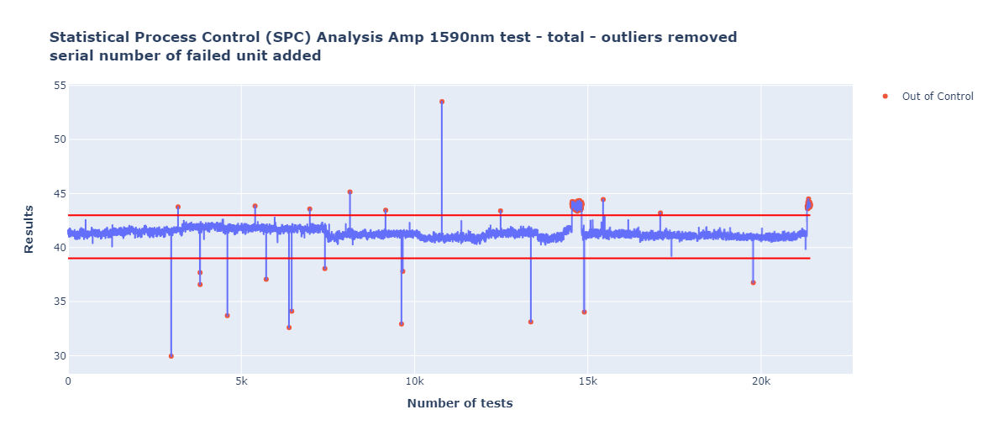
SPC analysis with majority outliers removed

Slide 10
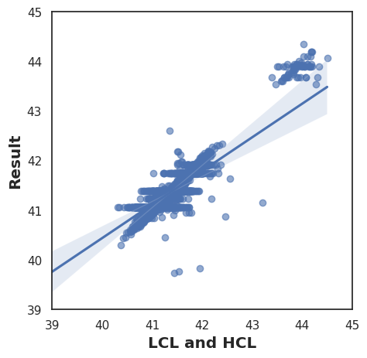
Logistic Regression analysis

Slide 11
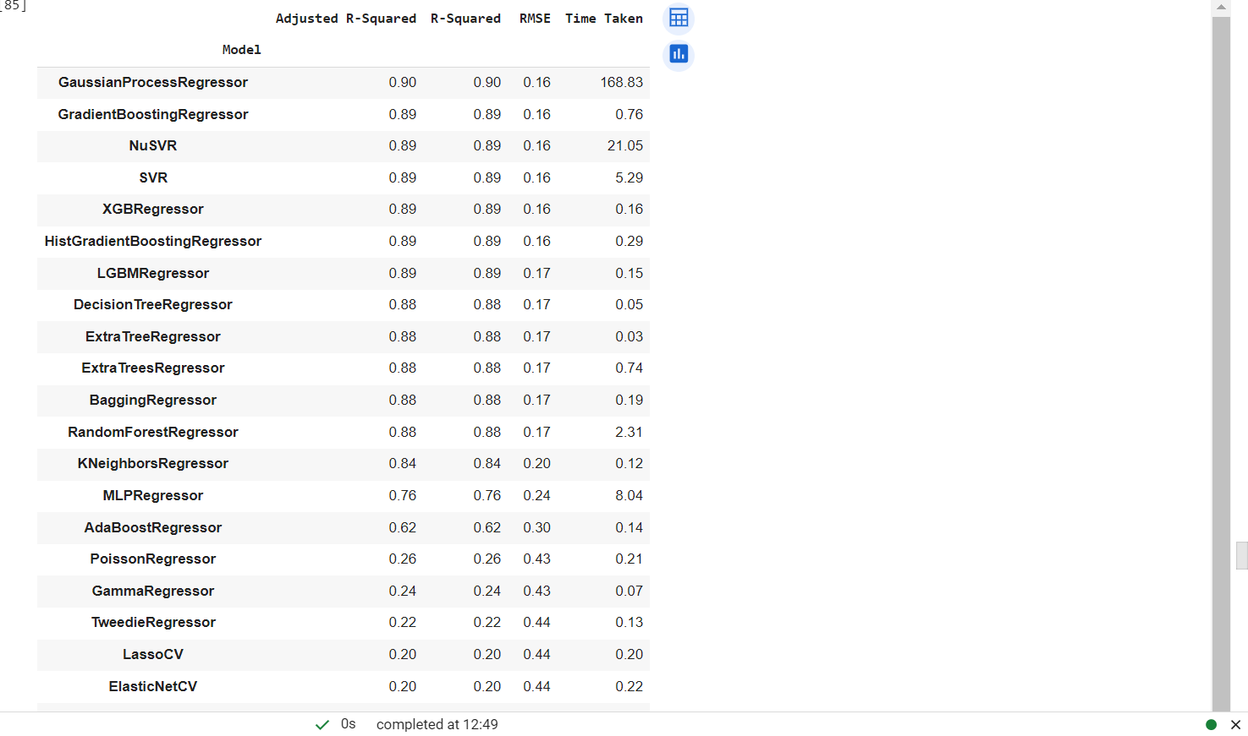
Initial Lazy Regressor results

Slide 12
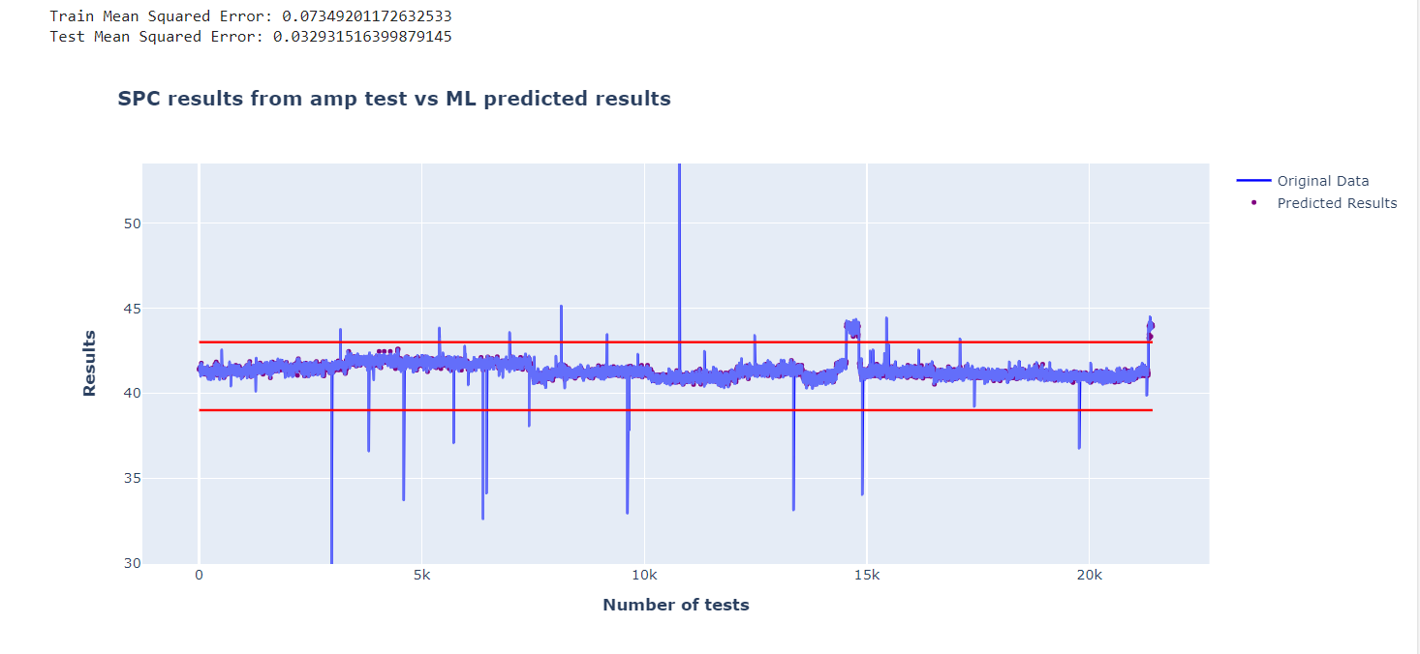
Initial predictions based on LCL and UCL labels using XGBoost

Slide 13
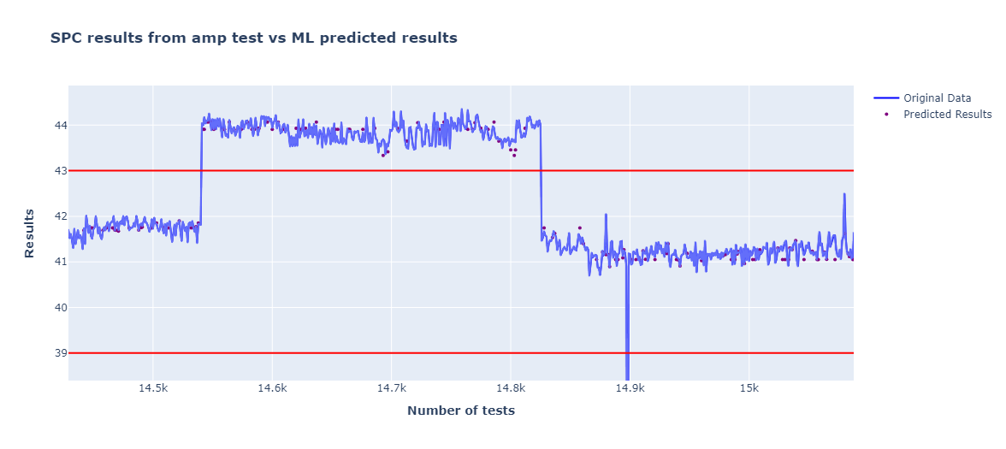
Zoomed in version

Slide 14
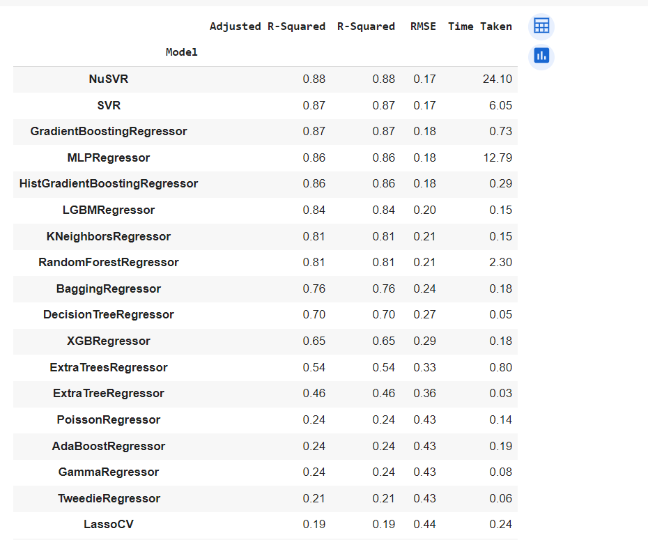
Adding pass/fail criteria as 1 or 0

Slide 15
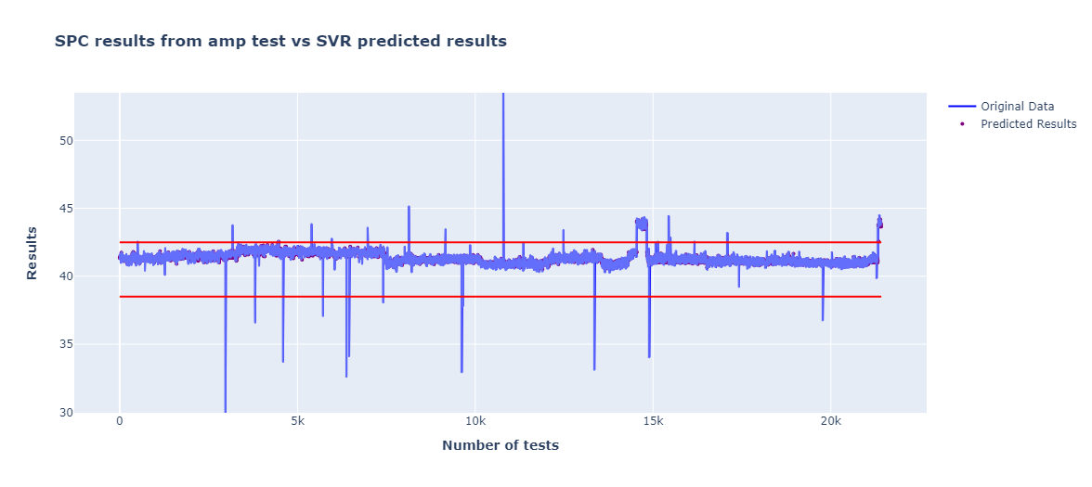
Initial predictions using SVR

Slide 16
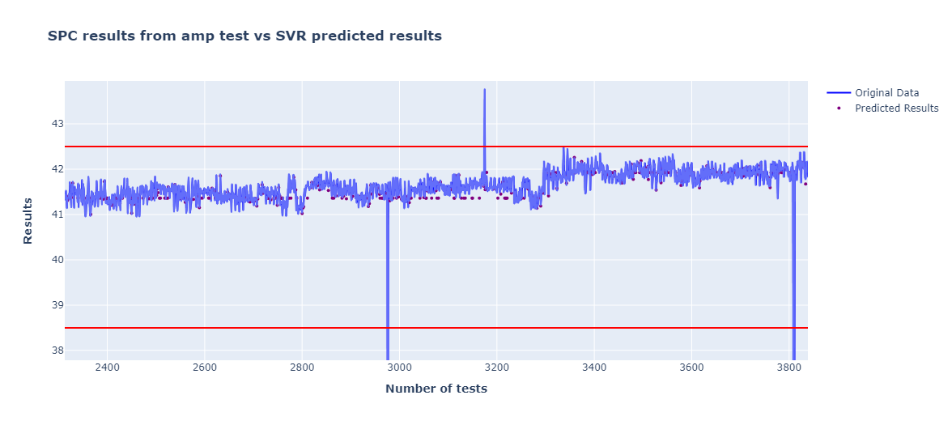
Zoomed in version

Slide 17
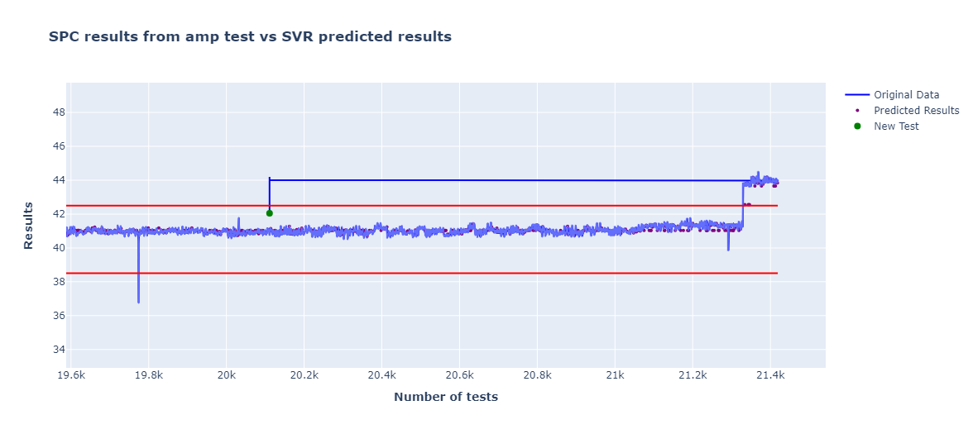
First prediction based on a set of known limits [41.523, 41.723, 0]
Predicted Result: [42.04383678]]

Slide 18
Thank you
Dean Foulds
dean.foulds@asn.com

